Slide 1




SAPC Provider Utilization Management Meeting
Los Angeles County Department of Public Health
June 17, 2026
Substance Abuse Prevention & Control

Slide 2
Agenda
Client Ineligible for Federal Programs (CIFP)
CIFP – Frequently Asked Questions (FAQ)
Reminder - Inter-County Transfer (ICT) of Medi-Cal benefits
SAPC Referral Process
Discussions/Questions

Slide 3





CIFP is Client Ineligible for Federal Programs:
This is a local LA County funding source created specifically for clients who have unsatisfactory immigration status and cannot qualify for Medi-Cal, other county funded or federal programs to pay for substance use treatment.

Slide 4
CIFP - Client Ineligible for Federal Programs
SAPC IN 26-02:
CIFP is specifically for clients with an at-risk immigration status whose treatment cannot be funded by any other means.
SAPC will use local dollars to continue to support provider agencies serving this population.

Slide 5
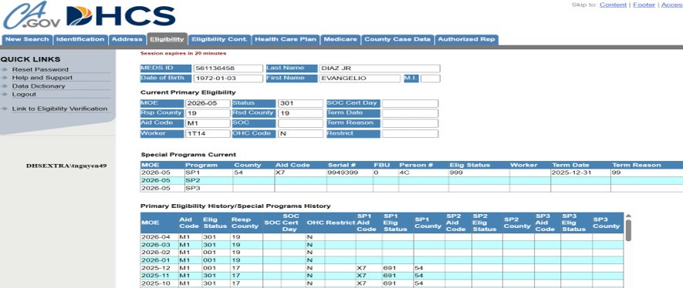
CIFP – Sample 1 of 5 – Missing CIFP Guarantor – LOC 3.5 - Non-DMC was selected as Other Funding Program
After check and review MedsLite – Currently has Aid Code M1 - full scope Medi-Cal, not eligible for CIFP funding.

Slide 6
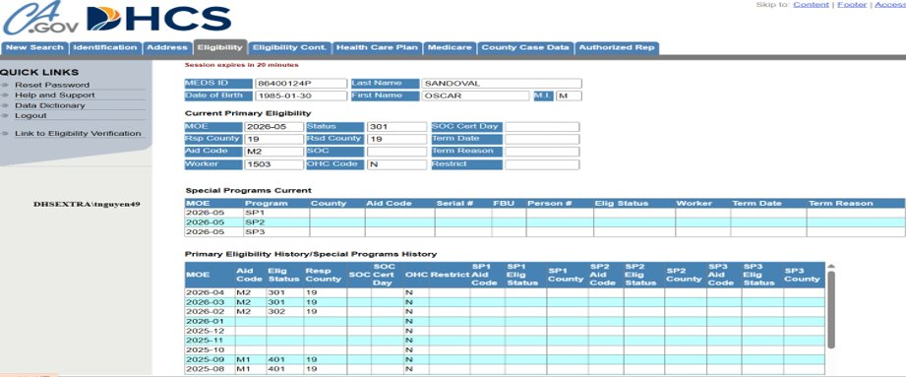

CIFP – Sample 2 of 5 – LOC – 1.0​
When Non-DMC is selected, must specify funding sources such (ex. CalFresh, AB 109, Drug Court, etc.)
After review – Aid Code M2 (Restricted Medi-Cal) - Not eligible for SUD treatment.

Slide 7
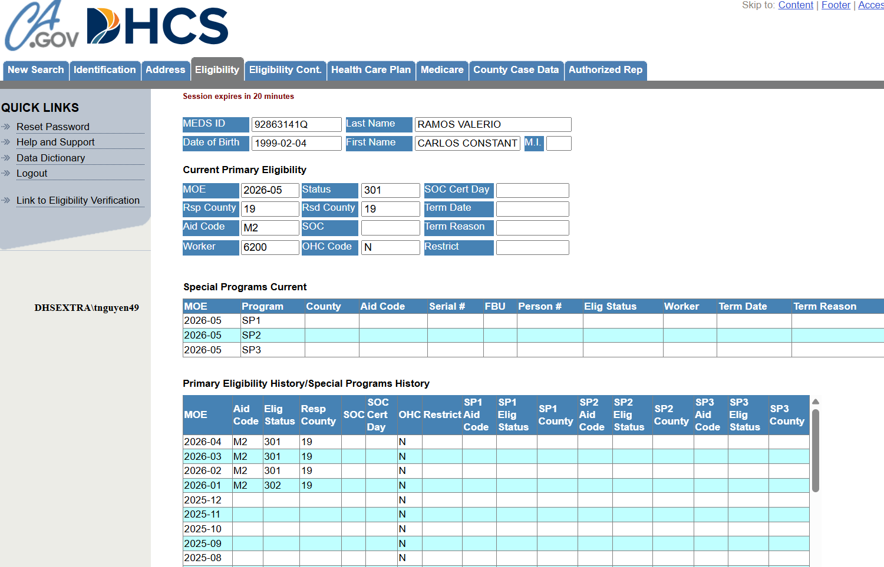
CIFP – Sample 3 of 5 – LOC – 2.1 – DMC was selected
Aid Code M2 Provides restricted Medi-Cal - Coverage is limited to emergency medical only, and it’s not eligible for SUD treatment

Slide 8
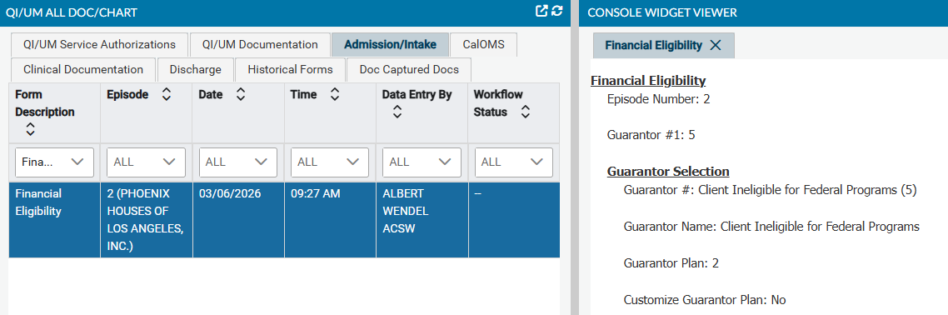




CIFP – Sample 4 of 5 – LOC – 3.5 – None was selected under Other Funding Program No CIN & No Meds ID on file – After full review and research, information is complete and correct

Slide 9
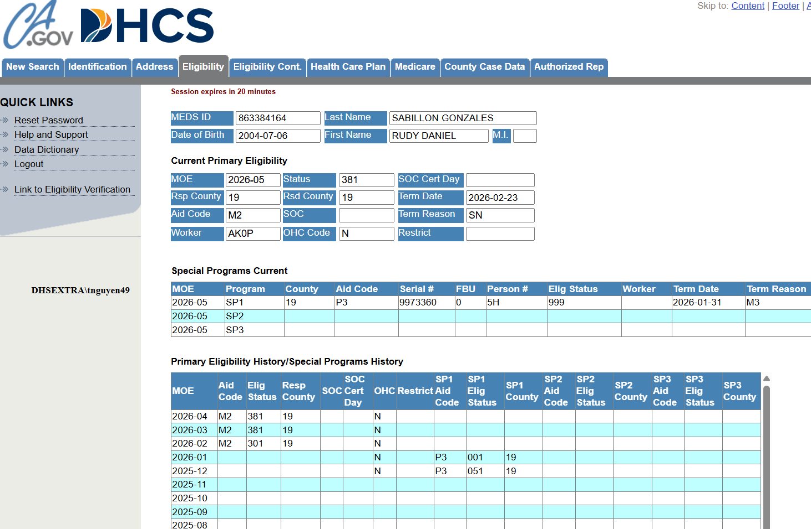

CIFP – Sample 5 of 5 – LOC 3.5 – DMC was selected
Aid Code M2 is restricted coverage only and SUD treatment is not covered.

Slide 10
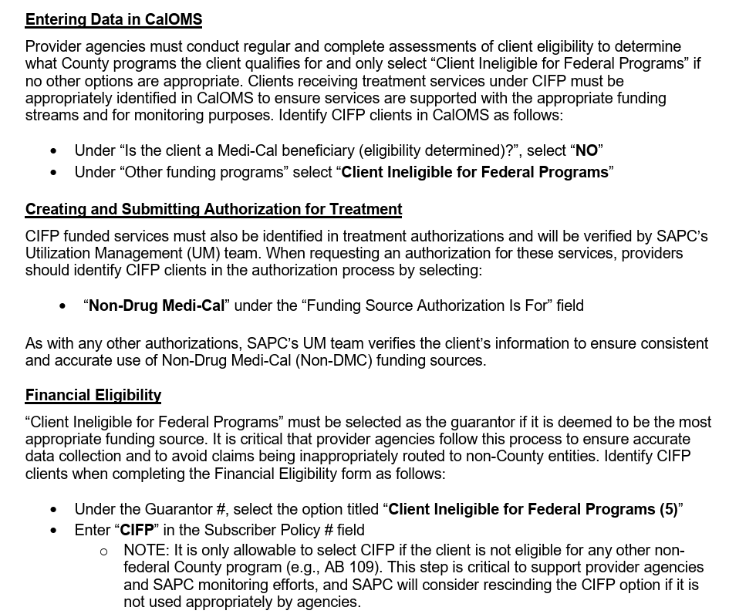
It appears the authorization was submitted via Drug Medi-Cal funding and CIFP was not indicated on the F.E. form.
Please follow the below steps which are from SAPC IN 26-03 to utilize CIFP Non-DMC funding for this client.

Slide 11
CIFP - Client Ineligible for Federal Programs
Please provide support to clients in completing Annual Redetermination and other required actions to ensure uninterrupted Medi‑Cal benefits and prevent loss of coverage.

Slide 12
Any Questions?

Slide 13
CIFP – Frequently Asked Questions (FAQ)

Slide 14
What is the Client Ineligible for Federal Programs (CIFP) and who qualifies for CIFP funding?
A new funding source available for Los Angeles County residents with substance use disorders in treatment with SAPC SUD providers in need of treatment, who because of their immigration status no longer qualify for Medi-Cal benefits and do not qualify for any other Non-DMC funding source.

Slide 15
What services are covered by CIFP?
The CIFP guarantor will cover the same services as DMC and RBH benefits.
Any service listed on the Rates and Standards Matrix will be covered exactly the same as other guarantors.

Slide 16
Will loss of Medi-Cal coverage start at the beginning of a given month, or can it occur anytime within the month?
Medi-Cal coverage can potentially be lost at any time during the month.

Slide 17
How is this going to be done for providers who have their own EHR?
SAPC cannot provide details on how Secondary Sage Users should configure their EHRs. It is recommended that Secondary Sage Users discuss if any changes are necessary in their EHR due to the addition of the new funding source. Cal-OMS, service authorizations and Financial Eligibility forms are required to be completed in Sage for both Primary and Secondary Sage Users. There will be no difference between this guarantor and DMC or Non-DMC for Secondary Sage Users.

Slide 18
Is there an aid code/s that are linked to CIFP that will show on the 271 response?
There are no aid codes that identify a Medi-Cal beneficiary as having an Unsatisfactory Immigration Status (UIS). Therefore, there are no aid codes linked to CIFP. These clients may have active Medi-Cal if enrolled between January 1, 2024, until December 31, 2025, and would have an aid code and results in the 270/271.
However, if the client has no eligibility or emergency Medi-Cal benefits, that will indicate they do not qualify for full scope Medi-Cal and the providers should determine if they are appropriate for CIFP depending on their immigration status.

Slide 19
The 270 can only be run if the client has a DMC guarantor in Sage with a Client Index Number (CIN) listed. For existing clients who have a DMC guarantor, providers should run the 270 monthly to verify coverage.
However, for new clients, if there is no known CIN, providers will be unable to run the 270. If there is a possibility of the client being enrolled in Medi-Cal, providers can check the eligibility system within the DHCS electronic verification system, Provider Portal, to search for the client.
Providers can contact the Eligibility Support Team for assistance at SAPC-EST@ph.lacounty.gov.
Do we run 270s for these clients?

Slide 20
Any Questions?

Slide 21
Is the enrollment freeze only for unsatisfactory immigration status (UIS) clients who are over the age of 18?
Children under 19 and those who are pregnant are still eligible for full-scope Medi-Cal. Pregnancy coverage lasts through the whole pregnancy and up to one year postpartum.
There are other exemptions to the Medi-Cal policies related to immigration status where the client may still qualify for coverage. CIFP is for those who are determined to not meet any other criteria for Medi-Cal and considered to have “unsatisfactory immigration status”.

Slide 22
Is this only for those whose immigration status is at risk or is there
other criteria, such as income that will make them eligible for this?
This is only for clients in treatment with the SAPC network of providers who are in need of SUD services, but do not qualify for any other funding due to their immigration status.
Income is not a criteria for this funding.

Slide 23
How do we access the Medi-Cal Eligibility Change Report?
This report can be found by searching in the Smart Search bar in Sage-PCNX for Medi-Cal Eligibility Change Report (no dash, but a space between Medi and Cal) or by going to My Forms and select Avatar PM. Next select Billing.
The Medi-Cal Eligibility Change Report can be found in Billing Reports. This was only assigned to staff with approved User Roles.

Slide 24
I ran the Medi-Cal Eligibility Change Report but it’s not listing all our clients. Is the report correct?
The information in the report is guided by the month entered in the inquiry and the month just prior to it. Only those clients whose Medi-Cal eligibility has changed during the designated period will show up in the report.

Slide 25
Will this population be eligible for RBH? YES
The CIFP guarantor will cover the same services as DMC and RBH benefits. Any service listed on the Rates and Standards Matrix will be covered exactly the same as other guarantors.

Slide 26
How can the client receive outpatient services without full scope Medi-Cal?
Clients with Medi-Cal only need DMC coverage to access any service within SAPC. Providers must check the aid code assigned by DPSS against the DHCS Medi-Cal Aid Code Chart to verify if the aid code has full scope coverage.
Clients who are not eligible for Medi-Cal or Other Funding Programs found in the CalOMS and have an unsatisfactory immigration status meet the criteria for CIFP. Providers can admit them under the CIFP funding/guarantor to receive any SAPC service.

Slide 27
For the existing client, does all the intake documentation need to be completed again when we discharge them from Cal-OMS and create the new admission. Is there any documentation that needs to be entered in the patient file to document this change?
No, provider agencies are not required to complete intake documentation.
Updates must be made in the Financial Eligibility.
The existing Cal-OMS admission must be discharged and a new Cal-OMS admission completed under the CIFP coverage in Other Funding Programs.

Slide 28
Any Questions?

Slide 29
Once admitted under CIFP do they get a Medi-Cal ID number?
No, this is not a Medi-Cal program, so no Medi-Cal ID is provided.
What about those who have Co-Occurring disorder?
Any client eligible for treatment in the SAPC provider network is eligible for CIFP if they meet the CIFP criteria. SAPC requires clients to have a primary SUD diagnosis, however, we can and should treat those with Co-Occurring disorders.
Providers should admit those clients and ensure they receive treatment for their Substance Use Disorder and any other Co-Occurring disorders. Providers should provide appropriate referrals and care coordination if they are unable to treat the Co-Occurring disorders internally.

Slide 30
What if the patient is not eligible or denied CIFP after admission?
Will we know the reason to fix or just discharge?
If a client is not eligible for CIFP then the CIFP guarantor should not be used.
It is the responsibility of the provider agency to accurately determine the funding source that applies to each client who enters treatment at the agency.
If you need assistance in making that determination, please contact by email to
SAPC-EST@ph.lacounty.gov
Clients are not to be discharged due to their immigration status.

Slide 31
Existing clients have 3 guarantors not 2 under financial eligibility?
It will depend on the guarantors the client previously had. If the client had only DMC and has lost coverage, the FE will only have 2 guarantors listed. If the client had DMC and lost coverage and also had Non-DMC funding coverage that was also lost, there would be 3 guarantors listed.
For all pre-existing clients, the CIFP guarantor must follow all previously entered guarantors.
Providers must enter the Coverage Expiration Date for CIFP clients who were previously Medi-Cal recipients and enter CIFP as the last guarantor regardless of how many other guarantors are entered.

Slide 32
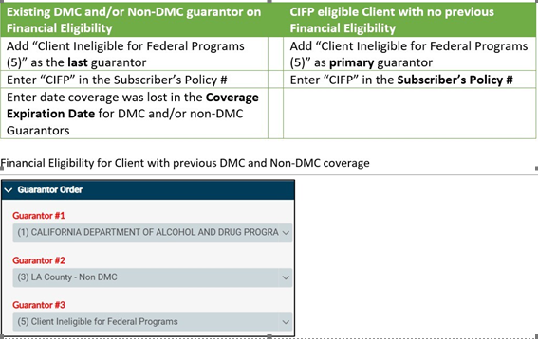
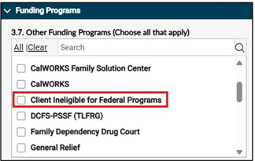

Slide 33
Do we need to change the order of the guarantors?
No, the order of the guarantors should remain the same and the CIFP guarantor should be added as the last guarantor.
Please note:
If a client has both DMC and Non-DMC funding sources and only loses their DMC benefits, the current Non-DMC funding source becomes the primary guarantor.
If the client is covered under another funding program (such as AB109, GR, DCFS).
In such cases, CIFP should NOT be added. Only the DMC guarantor would have the Coverage Expiration Date field completed.
If a client loses both DMC and Non-DMC then both guarantors would be end dated.

Slide 34
How do we enter the end date? What determines an end date? Would the expiration date be when the Medi-Cal benefits expire or the patient isn't eligible anymore?
The end date of Medi-Cal guarantor coverage is added in the Financial Eligibility form in the Coverage Expiration Date field.
An end date is determined by the last day a client has active full scope Medi-Cal coverage.
This is typically the last day of the previous month before benefits were terminated but could be another date.

Slide 35
How do we ensure clients aren't eligible for other county funding programs? AB-109 is easy, but what about other county funding streams? Are Drug Court participants, considered as other funding when Medi-Cal isn't applicable?
Determining other eligible county funding should be a part of the client referral, initial assessment and/or financial screening. Information gathered should point to aspects of the client’s background that lend to one of the qualifying funding sources.
Here is a list of the current funding sources available other than Medi-Cal that are listed on the Cal-OMS Admission form. If a client is covered under any of these additional sources, they would not qualify for CIFP, as those funding sources take priority. Even if the client is receiving GR, that non-DMC funding source should be used rather than CIFP.

Slide 36
▪ AB109
▪ Adult Drug Court
▪ CalWORKS
▪ CalWORKS (API)
▪ CalWORKS Detox
▪ CalWORKS Family Solution Center
▪ Client Ineligible for Federal Programs
▪ DCFS-PSSF (TLFRG)
▪ Family Dependency Drug Court
▪ General Relief
▪ Juvenile In Custody Probation Camp
▪ None
▪ Perinatal Service
▪ Private Pay
▪ Probation / Day Reporting Center
▪ Probation JJCPA
▪ Probation Title IV E
▪ Prop 47
▪ Prop 57
▪ Women Children's Residential Treatment

Slide 37
What do we put in the Subscriber Policy# in the Financial Eligibility form during admission since they won’t have a CIN number?
The CIN field should be left blank.
Would we need to submit another Authorization Request when we discharge the client in the Cal-OMS Admission due to a funding change/loss of Medi-Cal related to CIFP?
Providers should not request a new authorization if there is no lapse in treatment and the Cal-OMS Discharge is related to the new CIFP coverage only. In this situation, providers should continue to bill against the existing authorization. Providers should continue to match the Funding Source on the authorization to the Funding Source on the claim when entering.
However, any new admission for CIFP would require a new Non-DMC authorization.

Slide 38
The discrepant dates for the new Cal-OMS Admission and the authorization dates would not cause a problem, since that is one of the challenges we have with SAPC for authorization approval, right?
This should not cause any issues. However, it should be documented in a progress note why the Cal-OMS was discharged and a new Cal-OMS Admission completed to avoid any issues.
This would be a non-billable progress note that documents the current Cal-OMS episode was discharge and the client was re-admitted due to the change in funding source.

Slide 39
Providers are to assist clients who lose Medi-Cal benefits
When you observe that a client’s Medi-Cal benefit has recently been terminated
(or in other words is showing ineligible where client was previously eligible), please prioritize assisting the client in determining and completing any actions needed to renew or reestablish their benefits, if indicated (e.g. submit documents for annual Redetermination).
This will help in the effort to assist clients to not lose their Medi-Cal benefit which would make them ineligible to apply at a later time.

Slide 40
Any Questions?

Slide 41
A Brief Reminder
Inter-County Transfers (ICT) of Medi-Cal Benefits:
Medi-Cal (MC) transfer of benefits from one county to their new
county of residence ensuring no interruption or overlap of MC benefits

Slide 42
Processing Inter-County Transfers (ICT)
Contact Eligibility Support Team (DPH-SAPC-EST@ph.lacounty.gov) for help!
A training is available including:
How to complete a Medi-Cal ICT for a new admission
Selection of Guarantor
Documentation supporting transfer to Los Angeles County Effective Date
DPSS case#, address in the DPSS system
Name Search for those without SSN or CIN
Annual redetermination month
How to assist in lifting an incarceration suspension of Medi-Cal benefits
Electronic methods of verification of Residence – SAPCs expanded capabilities beyond what is available to providers
Instruction on BenefitsCal and the benefits for using it.

Slide 43
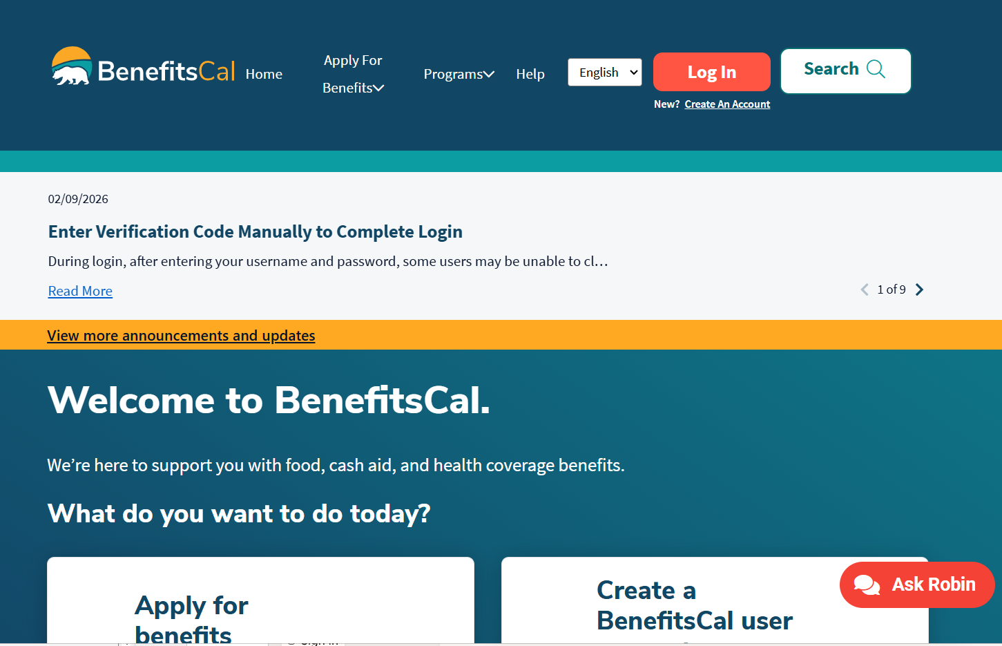
https://benefitscal.com/

Slide 44



If there are additional questions after using BenefitsCal, provider agencies may also contact SAPC to verify the information using the MEDS/MEDSLITE systems.
For assistance, email DPH-SAPC-EST@ph.lacounty.gov and include the following information in an encrypted email:
Client name, client PCNX ID, date of birth, the SSN/CIN, if available.

Slide 45

SAPC Referral Process

Slide 46
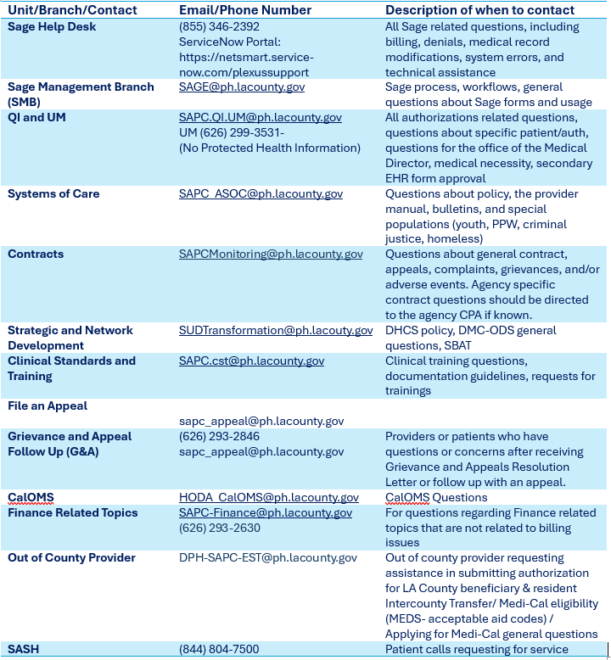
SAPC Referral Process

Slide 47

Discussions/Questions
“When you release the weight of yesterday, your hands finally open to tomorrow.”
- Original

